Slide 1
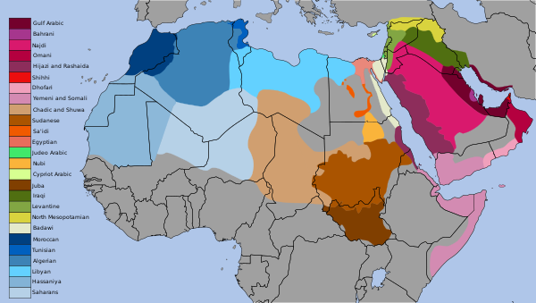
Arabic Dialect identification
Present by
Gena Magdy Ibrahim

Slide 2

AGENDA
Problem Definition
Pipeline
Results
Deployment

Slide 3
Problem definition
Many countries speak Arabic with different dialect and the objective to predict Arabic dialect
The dataset contains more than 458K tweets covering 18 dialects

Slide 4
Pipeline
Read
Clean
Normalize
Extract
Features
Modeling
and
Evaluation
I use 2 pipelines with different preprocessing

Slide 5
Pipeline
First Pipeline
Read data from API using this URL [https://recruitment.aimtechnologies.co/ai-tasks], this dataset contains more than 458K samples with 18 classes.
Clean data
- Remove all non-Arabic, digits, links, emotions, repeating letters.
- Remove stop-words like 'في','على', 'و‘
3. Normalize a text by strip tashkeel, strip tatweel, normalize Hamza, normalize Lam Alef, normalize Teh Marbuta and Alef Maksura
EX:
أستشتري دمـــى آلية لأبنائك قبل الإغلاق
استشتري دمي اليه لابناءك قبل الاغلاق

Slide 6
Pipeline (Cont.)
4. Extract features from a text by
- CountVectorizer with 1 ngram
- TfidfVectorizer with 1 ngram
5. Build models by MultinomialNB and LogisticRegression, evaluate a model by accuracy and f1-score
Features Extraction | Models | Test Data (20 % of 458K)
 |  | Accuracy | F1-Score
CountVectorizer | MultinomialNB | 0.49 | 0.41
 | LogisticRegression | 0.52 | 0.49
TfidfVectorizer | MultinomialNB | 0.40 | 0.27
 | LogisticRegression | 0.52 | 0.48

Slide 7
Pipeline (Cont.)
Second Pipeline
1. Read data from API using this URL [https://recruitment.aimtechnologies.co/ai-tasks], this dataset contains more than 458K samples with 18 classes, But I train on 16k in this pipeline
2. Clean data by ArabertPreprocessor
3. Extract features from a text by BertTokenizer and BertModel
4. Build models by MultinomialNB, LogisticRegression and LSTM, evaluate a model by accuracy and f1-score
Models | Test Data (10 % of 16K)
 | Accuracy | F1-Score
SVM | 0.18 | 0.14
LogisticRegression | 0.20 | 0.14

Slide 8
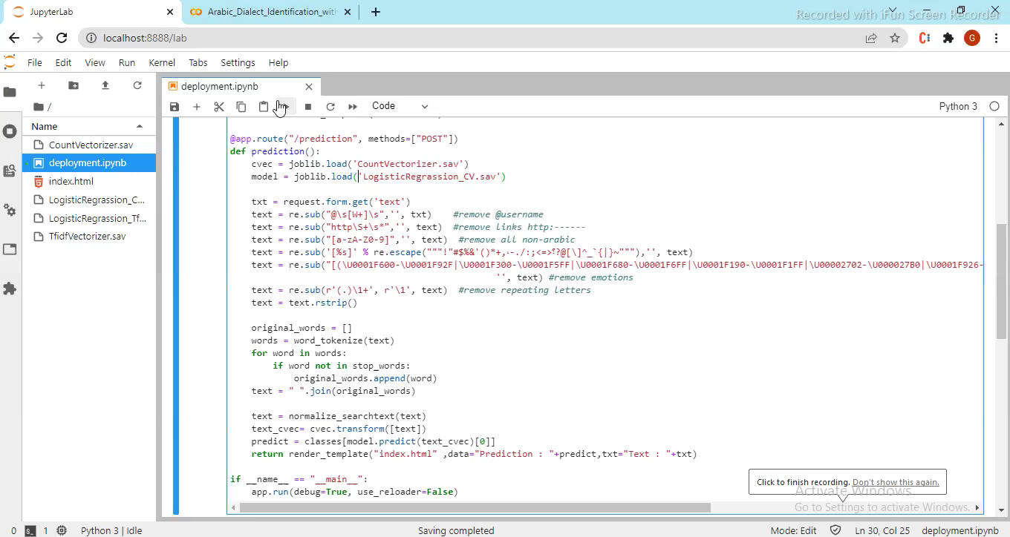
Deployment

Slide 9
Thank You

